Slide 1
Choosing the right trigonometric ratio
Trigonometry

Slide 2
How our teaching resources are designed for the classroom

Slide 3
I can choose the appropriate trigonometric ratio to use to solve problems in right-angled triangles.

Slide 4
The trigonometric ratios are ratios between each pair of lengths in a right-angled triangle:
sin(θ°) = opposite cos(θ°) = adjacent tan(θ°) = opposite
hypotenuse hypotenuse adjacent

Slide 5

Choosing the right trigonometric ratio
Choosing the correct trigonometric function
Using the ratios

Slide 6
Choosing the correct trigonometric function
In a triangle the proportional relationship between each pair of sides is set by the angles.
Each of the trigonometric functions (sine, cosine, tangent) find the multiplier between two sides of a right-angled triangle given one of the other angles.
× sin(𝜃°)
hyp
hyp
opp
× cos(𝜃°)
opp
𝜃°
𝜃°
𝜃°
adj
adj
× tan(𝜃°)

Slide 7
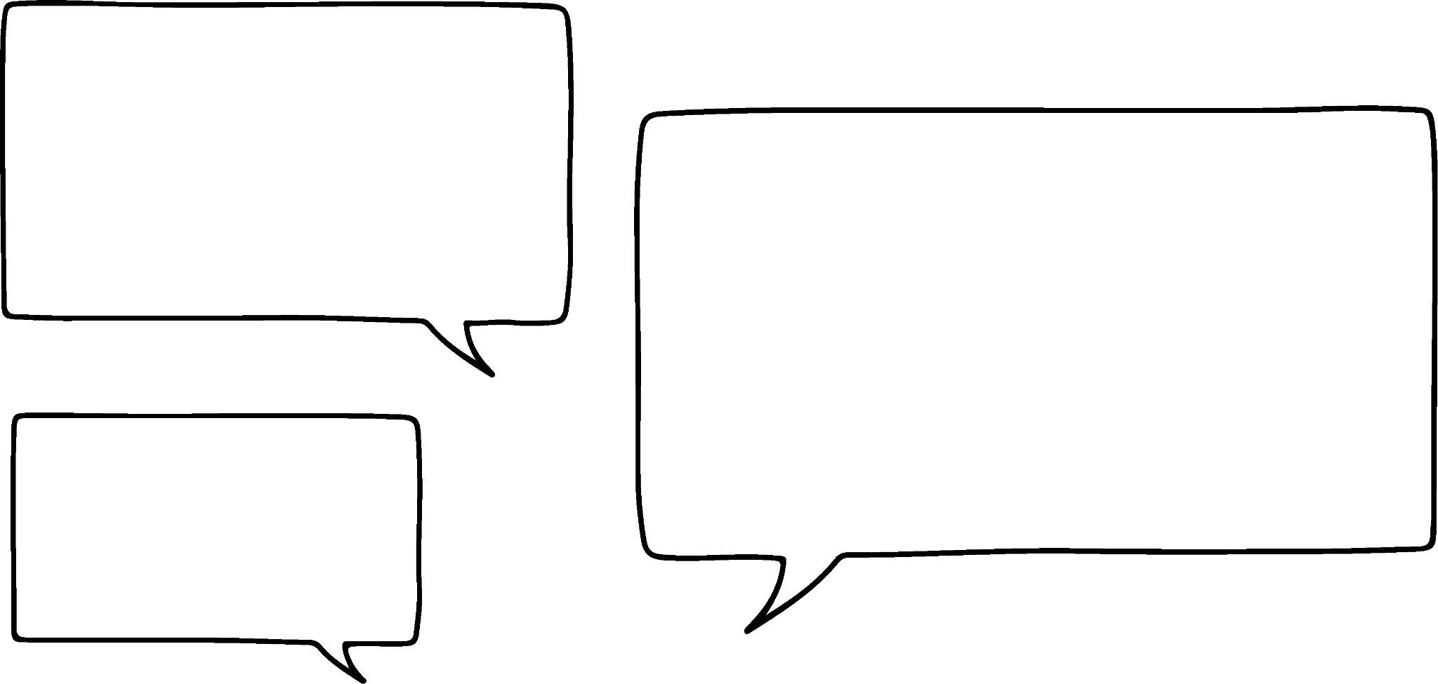
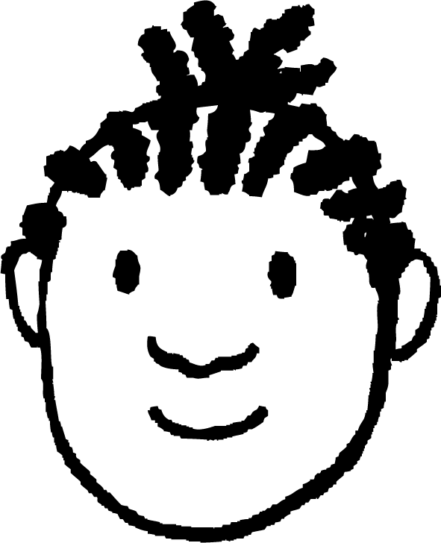
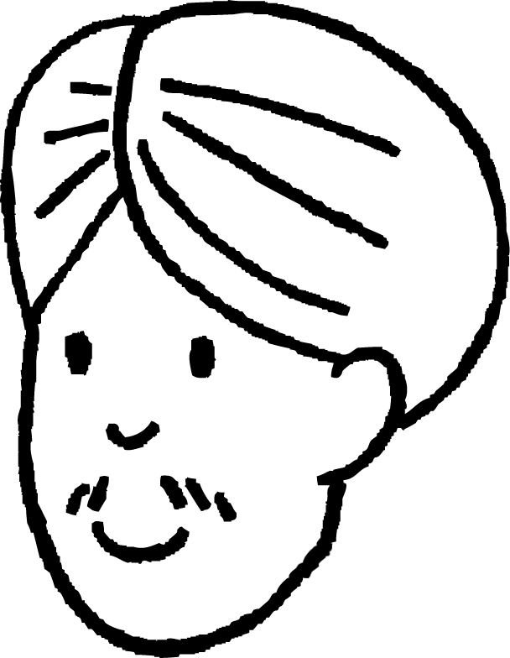
Choosing the correct trigonometric function
Which trigonometric function can we use to calculate the value of x?
x cm
58°
Sine - the 6 cm is opposite the 58° and x is the hypotenuse.
32°
6 cm
No, cosine - the 6 cm is adjacent to the 90° and 32° and x is the hypotenuse.
Jacob
Who do you agree with?
They are both correct. They have just chosen to use a different focus angle.
Andeep

Slide 8
Choosing the correct trigonometric function
Which trigonometric function can we use to calculate the value of x?
x cm
58°
6
sin(58°) =
32°
x
6
6 cm
x =
sin(58°)
6
cos(32°) =
x
x = 7.1 cm (1dp)
6
x =
cos(32°)
x = 7.1 cm (1dp)
Jacob
Both work out x correctly.
Andeep

Slide 9

Choosing the correct trigonometric function
If the 26° is the focus angle, which trigonometric function will you use to calculate the value of x?
9.2 cm
64°
sine
26°
x cm
cosine
tangent

Slide 10
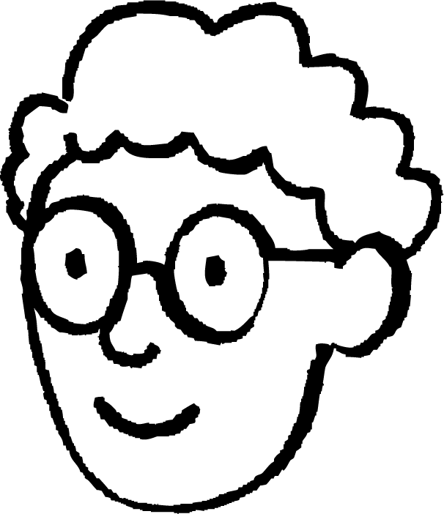
Choosing the correct trigonometric function
Given this information, what methods could be used to calculate the value of x?
h cm
x cm
58°
32°
I would use sine, to calculate the length of the hypotenuse, and then use sine again to calculate x.
6 cm
6
x
sin(58°) =
sin(32°) =
h
7.07…
6
h =
x =
7.07… × sin(32°)
sin(58°)
h = 7.07…
= 7.1 (1dp)
= 3.7 (1dp)
Alex

Slide 11
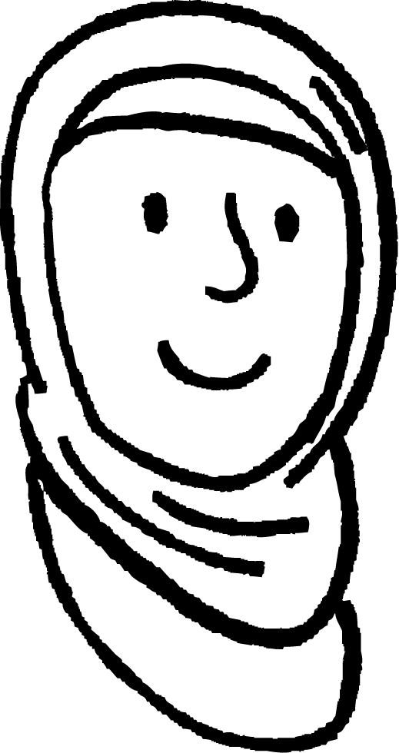
Choosing the correct trigonometric function
Given this information, what methods could be used to calculate the value of x?
h cm
x cm
58°
I would use cosine, to calculate the length of the hypotenuse, and then use sine to calculate x.
32°
6 cm
6
x
cos(32°) =
sin(32°) =
h
7.07…
6
h =
x =
7.07… × sin(32°)
cos(32°)
h = 7.0750…
= 7.1 (1dp)
x = 3.7 (1dp)
Aisha

Slide 12
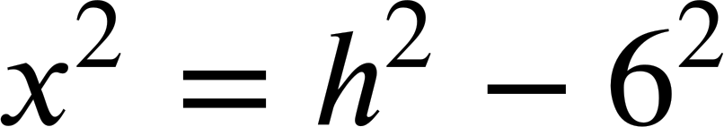


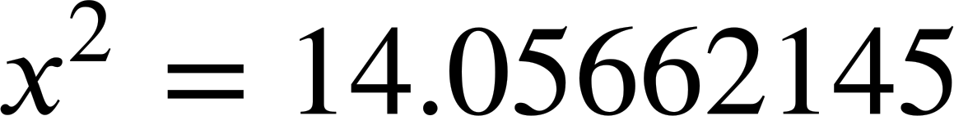
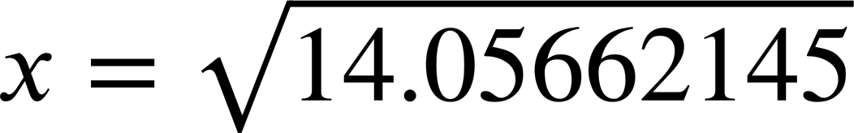
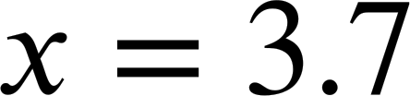
Choosing the correct trigonometric function
Given this information, what methods could be used to calculate the length of x?
h cm
x cm
58°
32°
I would use cosine or sine, to calculate the length of the hypotenuse, and then use Pythagoras’ Theorem.
6 cm
6
cos(32°) =
h
6
h =
cos(32°)
h = 7.07…
= 7.1 (1dp)
(1d.p.)
Jun

Slide 13
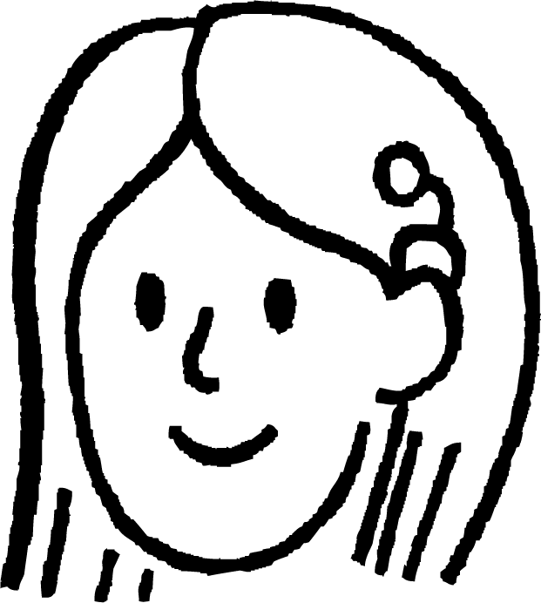
Choosing the correct trigonometric function
Given this information, what methods could be used to calculate the length of x?
x cm
58°
32°
6 cm
x
tan(32°) =
I would just use tangent to find x.
6
x = 6 × tan(32°)
x = 3.7 (1dp)
Sofia

Slide 14

Choosing the correct trigonometric function
The most efficient way to calculate x is to use the tangent function.
x cm
58°
Are all of these methods equivalent?
32°
6 cm
x
6
6
tan(32°) =
tan(32°) =
tan(58°) =
6
x
x
If the focus angle is 32° then the opposite is x cm and the adjacent is 6 cm.
If the focus angle is 58° then the opposite is 6 cm and the adjacent is x cm.
With the tangent function, it is really important to make sure the ‘opposite’ for your chosen angle is divided by the ‘adjacent’.

Slide 15
Choosing the correct trigonometric function
Complete the equation.
71°
4 cm
19°
x
tan ( °) =
71
x cm
4

Slide 16

Choosing the correct trigonometric function
The most efficient way to calculate x here is to use the sine function, but is there another way?
14.1 cm
x cm
63°
The third angle of this triangle can be calculated as 63°, then the edge marked x is the adjacent to the third angle and cosine could be used instead.
27°
This is always the case and it works the other way too.
x
x
sin(27°) =
cos(90° - 27°) =
14.1
14.1
x
cos(63°) =
14.1
Laura

Slide 17
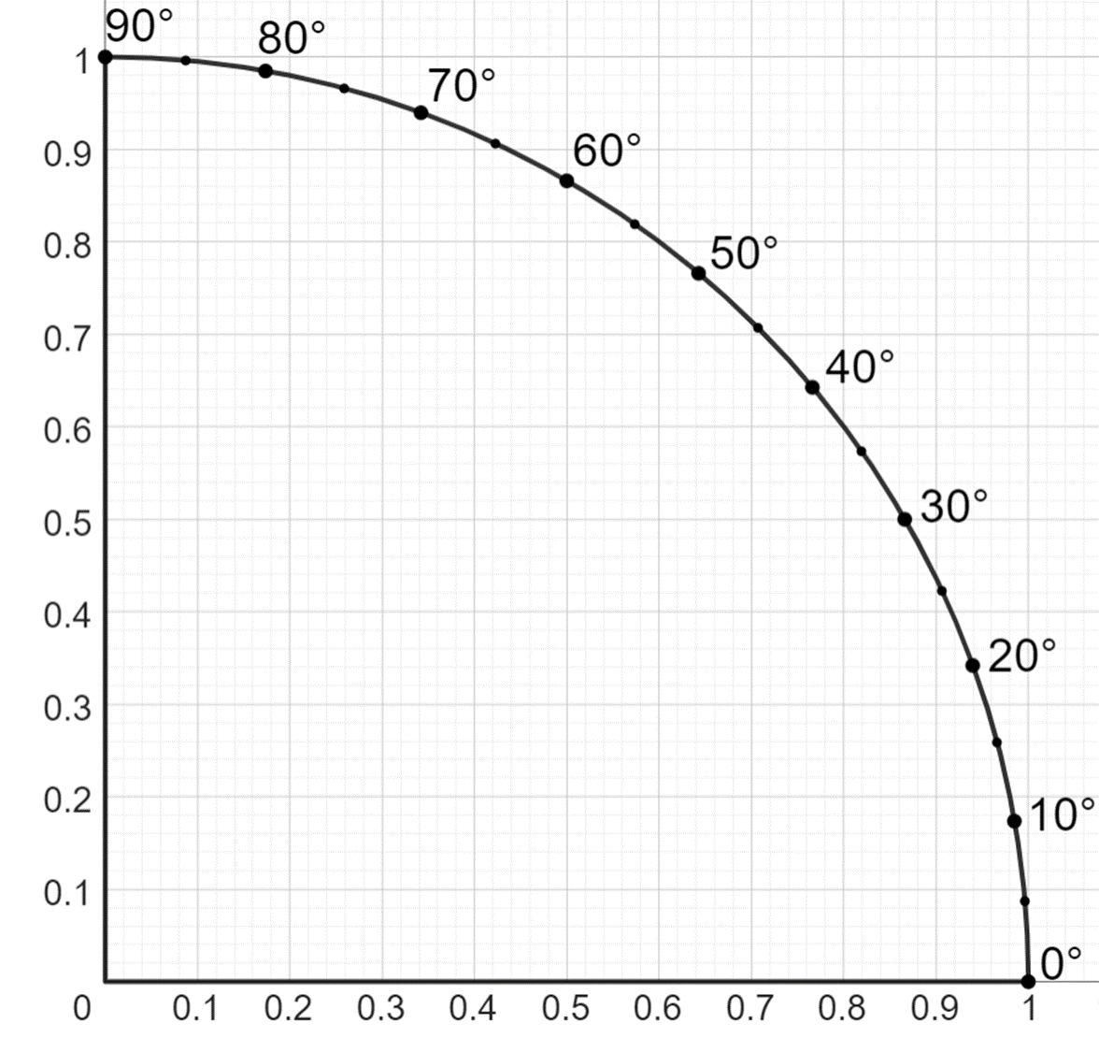
Choosing the correct trigonometric function
1 cm
63°
x cm
27°
We can see this on the unit circle.
sin(63°)
Opposite edges of a rectangle are equal.
sin(27°) = cos(63°)
cos(63°)
sin(27°)
63°
sin(63°) = cos(27°)
27°
cos(27°)

Slide 18
Choosing the correct trigonometric function
(90 - 𝜃)°
1 cm
𝜃°
sin((90 - 𝜃)°)
More generally,
sin(𝜃°) = cos(90° - 𝜃°)
cos((90 - 𝜃)°)
sin(𝜃°)
(90 - 𝜃)°
sin(90° - 𝜃°) = cos(𝜃°)
𝜃°
cos(𝜃°)

Slide 19
Choosing the correct trigonometric function
For every right-angled triangle, given either two edge lengths or one edge and one of the other angles, all three trigonometric functions can be used.
However one is normally more efficient than the other two in each question.
Given this information and asked to calculate the value of 𝜃 using sine would be the most efficient method.
30 cm
12 cm
𝜃°

Slide 20
Choosing the correct trigonometric function
Which trigonometric function would be the best to use for this question?
sine
3.8 cm
29°
x cm
cosine
tangent

Slide 21

Choosing the correct trigonometric function
1) Sort these triangles into the table, by which the most efficient trigonometric function to use is.
x cm
b
a
5.3 cm
33°
sine
cosine
tangent
29°
9 cm
x cm
17 m
𝜃°
8 m
3 cm
d
1.8 cm
c
𝜃°
x cm
5 cm
70°
f
31°
e
x cm
4 cm

Slide 22
Choosing the correct trigonometric function
2) Match the equation to the correct triangle.
𝜃°
𝜃°
30 cm
30 cm
𝜃°
30 cm
20 cm
20 cm
20 cm
20
20
20
sin(𝜃°) =
cos(𝜃°) =
tan(𝜃°) =
30
30
30

Slide 23
Choosing the correct trigonometric function
1) Sort these triangles into the table, regarding the most efficient trigonometric function to use.
x cm
a
b
sine
cosine
tangent
5.3 cm
33°
29°
9 cm
c
b
a
x cm
17 m
𝜃°
8 m
e
d
f
3 cm
d
1.8 cm
c
𝜃°
x cm
5 cm
70°
f
31°
e
x cm
4 cm

Slide 24
Choosing the correct trigonometric function
2) Match the equation to the correct triangle.
𝜃°
𝜃°
30 cm
30 cm
𝜃°
30 cm
20 cm
20 cm
20 cm
20
20
20
sin(𝜃°) =
cos(𝜃°) =
tan(𝜃°) =
30
30
30

Slide 25
Choosing the right trigonometric ratio
Choosing the correct trigonometric function
Using the ratios

Slide 26
Using the ratios
The trigonometric functions allow either an angle or an edge length to be calculated.
Using the definition triangle.
10 cm
1 cm
34°
34°
× 10
cos(34°) cm
t cm
adj | cos(34°) | t
hyp | 1 | 10
Calculate the length of t, to 1 d.p.
× cos(34°)
t = 10 × cos(34°)
× 10
t = 8.3 cm

Slide 27
Using the ratios
The trigonometric functions allow either an angle or an edge length to be calculated.
Using the formula.
10 cm
adj
cos(𝜃°) =
hyp
34°
t
t cm
cos(34°) =
10
Calculate the length of t, to 1 d.p.
t = 10 × cos(34°)
t = 8.3 cm

Slide 28
Using the ratios
Find the value of x, to 1 d.p.
Find the value of y, to 1 d.p.
6 cm
x cm
y cm
41°
29°
× 6
4 cm
× 4
opp | sin(41°) | x
hyp | 1 | 6
× sin(41°)
opp | tan(29°) | y
adj | 1 | 4
× tan(29°)
x = 6 × sin(41°)
y = 4 × tan(29°)
x = 3.9 cm
y = 2.2 cm

Slide 29
Using the ratios
Find the value of x, to 1 d.p.
Find the value of y, to 1 d.p.
7 cm
x cm
y cm
43°
30°
5 cm
x
sin(43°) =
y
7
tan(30°) =
5
x = 7 × sin(43°)
y = 5 × tan(30°)
x = 4.8 cm
y = 2.9 cm

Slide 30
Using the ratios
Each of the ratios includes two edges. How we calculate them depends on which edge it is.
Using the definition triangle.
Find the length of m, to 1 d.p.
1 cm
sin(41°) cm
m cm
41°
6 cm
×
6
41°
sin(41°)
sin(41°) | 6
1 | m
× sin(41°)
÷ sin(41°)
6
m =
= 9.1 cm
sin(41°)
×
6
sin(41°)

Slide 31
Using the ratios
Each of the ratios includes two edges. How we calculate them depends on which edge it is.
Using the formula.
Find the length of m, to 1 d.p.
opp
sin(𝜃°) =
m cm
hyp
6 cm
6
sin(41°) =
41°
m
m × sin(41°) = 6
6
m =
= 9.1 cm
sin(41°)

Slide 32
Using the ratios
Find the value of x to 1 d.p.
Find the value of y to 1 d.p.
y cm
5 cm
29°
34°
x cm
8 cm
tan(29°) | 5
1 | x
× cos(34°)
÷ cos(34°)
cos(34°) | 8
1 | y
× tan(29°)
÷ tan(29°)
5
8
x =
= 9.0
y =
= 9.6
tan(29°)
cos(34°)
The side labelled x is 9.0 cm long (1 d.p.).
The side y is 9.6 cm long (1 d.p.).

Slide 33
Using the ratios
The angle can also be calculated if the two edges are known.
Find 𝜃, to the nearest degree.
Using the definition triangle.
tan(𝜃°) cm
6 cm
𝜃°
𝜃°
× 11
1 cm
11 cm
tan(𝜃°) | 6
1 | 11
11tan(𝜃°) = 6
6
tan(𝜃°) =
× 11
11
6
𝜃° = tan⁻¹( )
11
𝜃° = 29°

Slide 34
Using the ratios
The angle can also be calculated if the two edges are known.
Find 𝜃, to the nearest degree.
Using the formula.
opp
6 cm
tan(𝜃°) =
adj
𝜃°
6
tan(𝜃°) =
11 cm
11
6
𝜃° = tan⁻¹( )
11
𝜃° = 29°

Slide 35
Using the ratios
Find the size of 𝜃, to the nearest degree.
Find the size of 𝜃, to the nearest degree.
12 cm
7 cm
3.5 cm
𝜃°
𝜃°
9 cm
× 12
× 7
cos(𝜃°) | 9
1 | 12
sin(𝜃°) | 3.5
1 | 7
12cos(𝜃°) = 9
7sin(𝜃°) = 3.5
cos(𝜃°) = 0.75
sin(𝜃°) = 0.5
× 12
× 7
𝜃° = cos⁻¹(0.75)
𝜃° = sin⁻¹(0.5)
𝜃° = 41°
𝜃° = 30°

Slide 36
Using the ratios
1) Calculate the length of the edge marked x, giving your answers to 1d.p.
Diagrams not drawn to scale
a)
b)
c)
x cm
6 cm
17 cm
63°
27°
71°
7 cm
x cm
g)
x cm
x cm
e)
f)
57°
d)
x cm
6 cm
11 cm
59°
72°
x cm
79°
x cm
4 cm
8 cm

Slide 37
Using the ratios
2) Calculate the size of the angle marked 𝜃, giving your answer to 1d.p.
Diagrams not drawn to scale
a)
b)
c)
9 cm
6.1 cm
12 cm
𝜃°
𝜃°
𝜃°
8 cm
6.8 cm
g)
4.5 cm
𝜃°
e)
f)
5.5 cm
d)
13 cm
8.8 cm
𝜃°
3 cm
𝜃°
11 cm
𝜃°
2.2 cm
7.9 cm
7.1 cm

Slide 38
Using the ratios
3) Calculate the size of the angle marked 𝜃 or the edge marked y, giving your answer to 1d.p.
Diagrams not drawn to scale
a)
b)
y cm
4 m
𝜃°
24°
9 m
6 cm
c)
d)
29°
32 mm
8.5 cm
42°
y cm
y mm

Slide 39
Using the ratios
1) Calculate the length of the edge marked x, giving your answer to 1d.p.
Diagrams not drawn to scale
a)
b)
c)
7.9 cm
6 cm
17 cm
63°
27°
71°
7 cm
6.7 cm
12.9 cm
g)
5.5 cm
e)
f)
57°
d)
9.3 cm
6 cm
11 cm
59°
72°
1.1 cm
79°
9.2 cm
4 cm
8 cm

Slide 40
Using the ratios
2) Calculate the size of the angle marked 𝜃, giving your answer to 1d.p.
Diagrams not drawn to scale
a)
b)
c)
9 cm
6.1 cm
12 cm
26.2°
27.3°
29.3°
65.4°
8 cm
6.8 cm
g)
4.5 cm
e)
f)
5.5 cm
d)
13 cm
8.8 cm
63.9°
3 cm
11 cm
25.0°
2.2 cm
32.2°
7.9 cm
7.1 cm

Slide 41
Using the ratios
3) Calculate the size of the angle marked 𝜃 or the edge marked y, giving your answer to 1d.p.
Diagrams not drawn to scale
a)
b)
6.6 cm
4 m
24.0°
24°
9 m
6 cm
c)
d)
29°
32 mm
8.5 cm
42°
4.7 cm
47.8 mm

Slide 42
Choosing the right trigonometric ratio
The trigonometric ratios describe the proportional relationship between two lengths in a right-angled triangle based on the size of the focus angle.
Determining which ratio to use is the first step in answering a question on trigonometry.
Sometimes what you need to calculate is not achieved in one calculation, so consider what you can calculate with the given information first. Consider accuracy, and don’t round until your final answer.

Slide 43

© Oak National Academy 2024.
Produced in partnership with Mathematics in Education and Industry.
Licensed on the Open Government Licence v3.0, except where otherwise stated. See Oak terms and conditions.

